Slide 1

SIT1302 Internet Programming
UNIT 5
ASP.NET
Ms.J.S.Vimali
SIT1302 School of Computing

Slide 2
ASP stands for Active Server Pages
ASP is a development framework for building web pages.
ASP supports many different development models:
Classic ASP
ASP.NET Web Forms
ASP.NET MVC
ASP.NET Web Pages
ASP.NET API
ASP.NET Core
The ASP Technology
ASP and ASP.NET are server side technologies.
Both technologies enable computer code to be executed by an Internet server.
When a browser requests an ASP or ASP.NET file, the ASP engine reads the file, executes any code in the file, and returns the result to the browser.
SIT1302 School of Computing

Slide 3
Classic ASP - Active Server Pages
ASP (aka Classic ASP) was introduced in 1998 as Microsoft's first server side scripting language.
Classic ASP pages have the file extension .asp and are normally written in VBScript.
ASP.NET
ASP.NET was released in 2002 as a successor to Classic ASP.
ASP.NET pages have the extension .aspx and are normally written in C# (C sharp).
ASP.NET 4.6 is the latest official version of ASP.NET.
ASP.NET 5 was expected to be an important redesign of ASP.NET.
It is built on the Common Language Runtime (CLR) and allows programmers to write code using any supported .NET language.
SIT1302 School of Computing

Slide 4
ASP.NET is a web development platform, which provides a programming model, a comprehensive software infrastructure and various services required to build up robust web applications for PC, as well as mobile devices.
ASP.NET works on top of the HTTP protocol, and uses the HTTP commands and policies to set a browser-to-server bilateral communication and cooperation.
ASP.NET is a part of Microsoft .Net platform. ASP.NET applications are compiled codes, written using the extensible and reusable components or objects present in .Net framework. These codes can use the entire hierarchy of classes in .Net framework.
SIT1302 School of Computing

Slide 5
The ASP.NET application codes can be written in any of the following languages:
C#
Visual Basic.Net
Jscript
J#
ASP.NET is used to produce interactive, data-driven web applications over the internet. It consists of a large number of controls such as text boxes, buttons, and labels for assembling, configuring, and manipulating code to create HTML pages.
ASP.NET Web Forms Model
ASP.NET web forms extend the event-driven model of interaction to the web applications. The browser submits a web form to the web server and the server returns a full markup page or HTML page in response.
All client side user activities are forwarded to the server for stateful processing. The server processes the output of the client actions and triggers the reactions.
SIT1302 School of Computing

Slide 6
Now, HTTP is a stateless protocol. ASP.NET framework helps in storing the information regarding the state of the application, which consists of:
Page state
Session state
The page state is the state of the client, i.e., the content of various input fields in the web form. The session state is the collective information obtained from various pages the user visited and worked with, i.e., the overall session state. To clear the concept, let us take an example of a shopping cart.
User adds items to a shopping cart. Items are selected from a page, say the items page, and the total collected items and price are shown on a different page, say the cart page. Only HTTP cannot keep track of all the information coming from various pages. ASP.NET session state and server side infrastructure keeps track of the information collected globally over a session.
The ASP.NET runtime carries the page state to and from the server across page requests while generating ASP.NET runtime codes, and incorporates the state of the server side components in hidden fields.
This way, the server becomes aware of the overall application state and operates in a two-tiered connected way.
SIT1302 School of Computing

Slide 7
The ASP.NET Component Model
The ASP.NET component model provides various building blocks of ASP.NET pages. Basically it is an object model, which describes:
Server side counterparts of almost all HTML elements or tags, such as <form> and <input>.
Server controls, which help in developing complex user-interface. For example, the Calendar control or the Gridview control.
ASP.NET is a technology, which works on the .Net framework that contains all web-related functionalities. The .Net framework is made of an object-oriented hierarchy. An ASP.NET web application is made of pages. When a user requests an ASP.NET page, the IIS delegates the processing of the page to the ASP.NET runtime system.
The ASP.NET runtime transforms the .aspx page into an instance of a class, which inherits from the base class page of the .Net framework. Therefore, each ASP.NET page is an object and all its components i.e., the server-side controls are also objects.
SIT1302 School of Computing

Slide 8
Components of .Net Framework 3.5
Before going to the next session on Visual Studio.Net, let us go through at the various components of the .Net framework 3.5. The following table describes the components of the .Net framework 3.5 and the job they perform:
Components and their Description
(1) Common Language Runtime or CLR
It performs memory management, exception handling, debugging, security checking, thread execution, code execution, code safety, verification, and compilation. The code that is directly managed by the CLR is called the managed code. When the managed code is compiled, the compiler converts the source code into a CPU independent intermediate language (IL) code. A Just In Time(JIT) compiler compiles the IL code into native code, which is CPU specific.
(2) .Net Framework Class Library
It contains a huge library of reusable types. classes, interfaces, structures, and enumerated values, which are collectively called types.
(3) Common Language Specification
It contains the specifications for the .Net supported languages and implementation of language integration.
SIT1302 School of Computing

Slide 9
(4) Common Type System
It provides guidelines for declaring, using, and managing types at runtime, and cross-language communication.
(5) Metadata and Assemblies
Metadata is the binary information describing the program, which is either stored in a portable executable file (PE) or in the memory. Assembly is a logical unit consisting of the assembly manifest, type metadata, IL code, and a set of resources like image files.
(6) Windows Forms
Windows Forms contain the graphical representation of any window displayed in the application.
(7) ASP.NET and ASP.NET AJAX
ASP.NET is the web development model and AJAX is an extension of ASP.NET for developing and implementing AJAX functionality. ASP.NET AJAX contains the components that allow the developer to update data on a website without a complete reload of the page.
(8) ADO.NET
It is the technology used for working with data and databases. It provides access to data sources like SQL server, OLE DB, XML etc. The ADO.NET allows connection to data sources for retrieving, manipulating, and updating data.
SIT1302 School of Computing

Slide 10
(9) Windows Workflow Foundation (WF)
It helps in building workflow-based applications in Windows. It contains activities, workflow runtime, workflow designer, and a rules engine.
(10) Windows Presentation Foundation
It provides a separation between the user interface and the business logic. It helps in developing visually stunning interfaces using documents, media, two and three dimensional graphics, animations, and more.
(11) Windows Communication Foundation (WCF)
It is the technology used for building and executing connected systems.
(12) Windows CardSpace
It provides safety for accessing resources and sharing personal information on the internet.
(13) LINQ
It imparts data querying capabilities to .Net languages using a syntax which is similar to the tradition query language SQL.
SIT1302 School of Computing

Slide 11
ASP.NET - Life Cycle
ASP.NET life cycle specifies, how:
ASP.NET processes pages to produce dynamic output
The application and its pages are instantiated and processed
ASP.NET compiles the pages dynamically
The ASP.NET life cycle could be divided into two groups:
Application Life Cycle
Page Life Cycle
ASP.NET Application Life Cycle
The application life cycle has the following stages:
User makes a request for accessing application resource, a page. Browser sends this request to the web server.
A unified pipeline receives the first request and the following events take place:
An object of the class ApplicationManager is created.
An object of the class HostingEnvironment is created to provide information regarding the resources.
Top level items in the application are compiled.
SIT1302 School of Computing

Slide 12
Response objects are created. The application objects such as HttpContext, HttpRequest and HttpResponse are created and initialized.
An instance of the HttpApplication object is created and assigned to the request.
The request is processed by the HttpApplication class. Different events are raised by this class for processing the request.
ASP.NET Page Life Cycle
When a page is requested, it is loaded into the server memory, processed, and sent to the browser. Then it is unloaded from the memory. At each of these steps, methods and events are available, which could be overridden according to the need of the application. In other words, you can write your own code to override the default code.
The Page class creates a hierarchical tree of all the controls on the page. All the components on the page, except the directives, are part of this control tree. You can see the control tree by adding trace= "true" to the page directive. We will cover page directives and tracing under 'directives' and 'event handling‘.
SIT1302 School of Computing

Slide 13
The page life cycle phases are:
Initialization
Instantiation of the controls on the page
Restoration and maintenance of the state
Execution of the event handler codes
Page rendering
Following are the different stages of an ASP.NET page:
Page request - When ASP.NET gets a page request, it decides whether to parse and compile the page, or there would be a cached version of the page; accordingly the response is sent.
Starting of page life cycle - At this stage, the Request and Response objects are set. If the request is an old request or post back, the IsPostBack property of the page is set to true. The UICulture property of the page is also set.
Page initialization - At this stage, the controls on the page are assigned unique ID by setting the UniqueID property and the themes are applied. For a new request, postback data is loaded and the control properties are restored to the view-state values.
Page load - At this stage, control properties are set using the view state and control state values.
Validation - Validate method of the validation control is called and on its successful execution, the IsValid property of the page is set to true.
SIT1302 School of Computing

Slide 14
Postback event handling - If the request is a postback (old request), the related event handler is invoked.
Page rendering - At this stage, view state for the page and all controls are saved. The page calls the Render method for each control and the output of rendering is written to the OutputStream class of the Response property of page.
Unload - The rendered page is sent to the client and page properties, such as Response and Request, are unloaded and all cleanup done.
ASP.NET Page Life Cycle Events
At each stage of the page life cycle, the page raises some events, which could be coded. An event handler is basically a function or subroutine, bound to the event, using declarative attributes such as Onclick or handle.
Following are the page life cycle events:
PreInit - PreInit is the first event in page life cycle. It checks the IsPostBack property and determines whether the page is a postback. It sets the themes and master pages, creates dynamic controls, and gets and sets profile property values. This event can be handled by overloading the OnPreInit method or creating a Page_PreInit handler.
SIT1302 School of Computing

Slide 15
Init - Init event initializes the control property and the control tree is built. This event can be handled by overloading the OnInit method or creating a Page_Init handler.
InitComplete - InitComplete event allows tracking of view state. All the controls turn on view-state tracking.
LoadViewState - LoadViewState event allows loading view state information into the controls.
LoadPostData - During this phase, the contents of all the input fields are defined with the <form> tag are processed.
PreLoad - PreLoad occurs before the post back data is loaded in the controls. This event can be handled by overloading the OnPreLoad method or creating a Page_PreLoad handler.
Load - The Load event is raised for the page first and then recursively for all child controls. The controls in the control tree are created. This event can be handled by overloading the OnLoad method or creating a Page_Load handler.
LoadComplete - The loading process is completed, control event handlers are run, and page validation takes place. This event can be handled by overloading the OnLoadComplete method or creating a Page_LoadComplete handler
PreRender - The PreRender event occurs just before the output is rendered. By handling this event, pages and controls can perform any updates before the output is rendered.
SIT1302 School of Computing

Slide 16
PreRenderComplete - As the PreRender event is recursively fired for all child controls, this event ensures the completion of the pre-rendering phase.
SaveStateComplete - State of control on the page is saved. Personalization, control state and view state information is saved. The HTML markup is generated. This stage can be handled by overriding the Render method or creating a Page_Render handler.
UnLoad - The UnLoad phase is the last phase of the page life cycle. It raises the UnLoad event for all controls recursively and lastly for the page itself. Final cleanup is done and all resources and references, such as database connections, are freed. This event can be handled by modifying the OnUnLoad method or creating a Page_UnLoad handler.
SIT1302 School of Computing

Slide 17
ASP.NET - Event Handling
An event is an action or occurrence such as a mouse click, a key press, mouse movements, or any system-generated notification. A process communicates through events. For example, interrupts are system-generated events. When events occur, the application should be able to respond to it and manage it.
Events in ASP.NET raised at the client machine, and handled at the server machine. For example, a user clicks a button displayed in the browser. A Click event is raised. The browser handles this client-side event by posting it to the server.
The server has a subroutine describing what to do when the event is raised; it is called the event-handler. Therefore, when the event message is transmitted to the server, it checks whether the Click event has an associated event handler. If it has, the event handler is executed.
Application and Session Events
The most important application events are:
Application_Start - It is raised when the application/website is started.
Application_End - It is raised when the application/website is stopped.
Similarly, the most used Session events are:
Session_Start - It is raised when a user first requests a page from the application.
Session_End - It is raised when the session ends.
SIT1302 School of Computing

Slide 18
Page and Control Events
Common page and control events are:
DataBinding - It is raised when a control binds to a data source.
Disposed - It is raised when the page or the control is released.
Error - It is a page event, occurs when an unhandled exception is thrown.
Init - It is raised when the page or the control is initialized.
Load - It is raised when the page or a control is loaded.
PreRender - It is raised when the page or the control is to be rendered.
Unload - It is raised when the page or control is unloaded from memory.
Event Arguments
ASP.NET event handlers generally take two parameters and return void. The first parameter represents the object raising the event and the second parameter is event argument.
The general syntax of an event is:
private void EventName (object sender, EventArgs e);
SIT1302 School of Computing

Slide 19
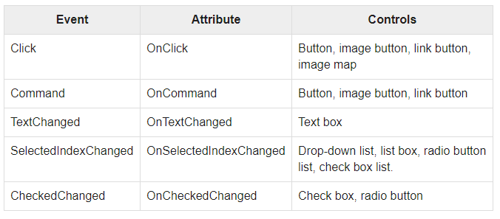
The common control events are:
Some events cause the form to be posted back to the server immediately, these are called the postback events. For example, the click event such as, Button.Click.
Some events are not posted back to the server immediately, these are called non-postback events.
For example, the change events or selection events such as TextBox.TextChanged or CheckBox.CheckedChanged. The nonpostback events could be made to post back immediately by setting their AutoPostBack property to true.
SIT1302 School of Computing

Slide 20
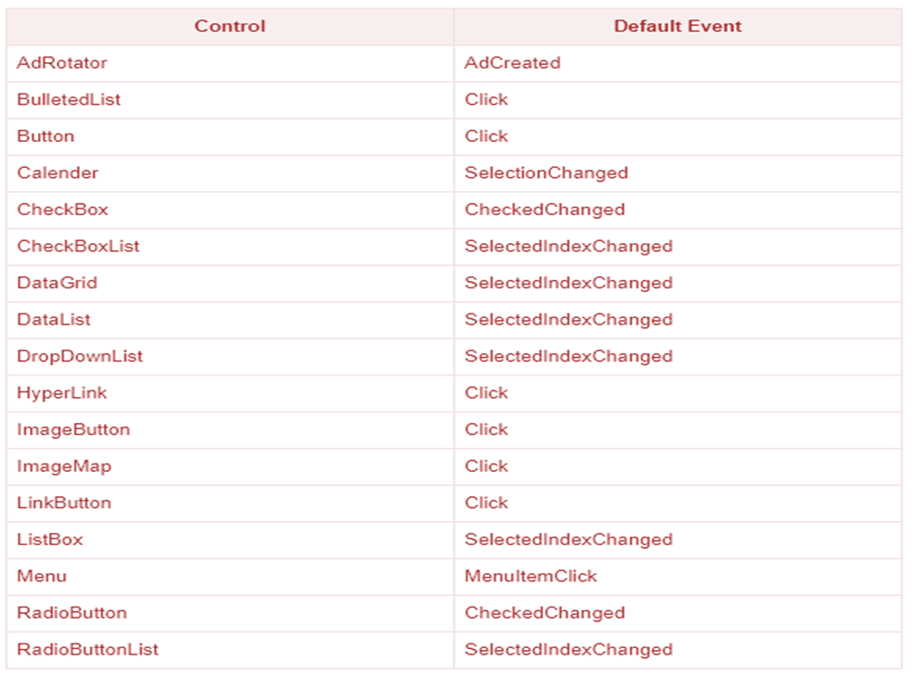
Default Events
The default event for the Page object is Load event. Similarly, every control has a default event. For example, default event for the button control is the Click event.
The default event handler could be created in Visual Studio, just by double clicking the control in design view. The following table shows some of the default events for common controls:
SIT1302 School of Computing

Slide 21
ASP.NET - Server Controls
Controls are small building blocks of the graphical user interface, which include text boxes, buttons, check boxes, list boxes, labels, and numerous other tools. Using these tools, the users can enter data, make selections and indicate their preferences.
Controls are also used for structural jobs, like validation, data access, security, creating master pages, and data manipulation.
ASP.NET uses five types of web controls, which are:
HTML controls
HTML Server controls
ASP.NET Server controls
ASP.NET Ajax Server controls
User controls and custom controls
ASP.NET server controls are the primary controls used in ASP.NET. These controls can be grouped into the following categories:
Validation controls - These are used to validate user input and they work by running client-side script.
Data source controls - These controls provides data binding to different data sources.
SIT1302 School of Computing

Slide 22
Data view controls - These are various lists and tables, which can bind to data from data sources for displaying.
Personalization controls - These are used for personalization of a page according to the user preferences, based on user information.
Personalization controls - These are used for personalization of a page according to the user preferences, based on user information.
Login and security controls - These controls provide user authentication.
Master pages - These controls provide consistent layout and interface throughout the application.
Navigation controls - These controls help in navigation. For example, menus, tree view etc.
Rich controls - These controls implement special features. For example, AdRotator, FileUpload, and Calendar control.
ASP.NET - HTML Server
The HTML server controls are basically the standard HTML controls enhanced to enable server side processing. The HTML controls such as the header tags, anchor tags, and input elements are not processed by the server but are sent to the browser for display.
SIT1302 School of Computing

Slide 23
They are specifically converted to a server control by adding the attribute runat="server" and adding an id attribute to make them available for server-side processing.
For example, consider the HTML input control:
<input type="text" size="40">
It could be converted to a server control, by adding the runat and id attribute:
<input type="text" id="testtext" size="40" runat="server">
Advantages of using HTML Server Controls
Although ASP.NET server controls can perform every job accomplished by the HTML server controls, the later controls are useful in the following cases:
Using static tables for layout purposes.
Converting a HTML page to run under ASP.NET
SIT1302 School of Computing

Slide 24
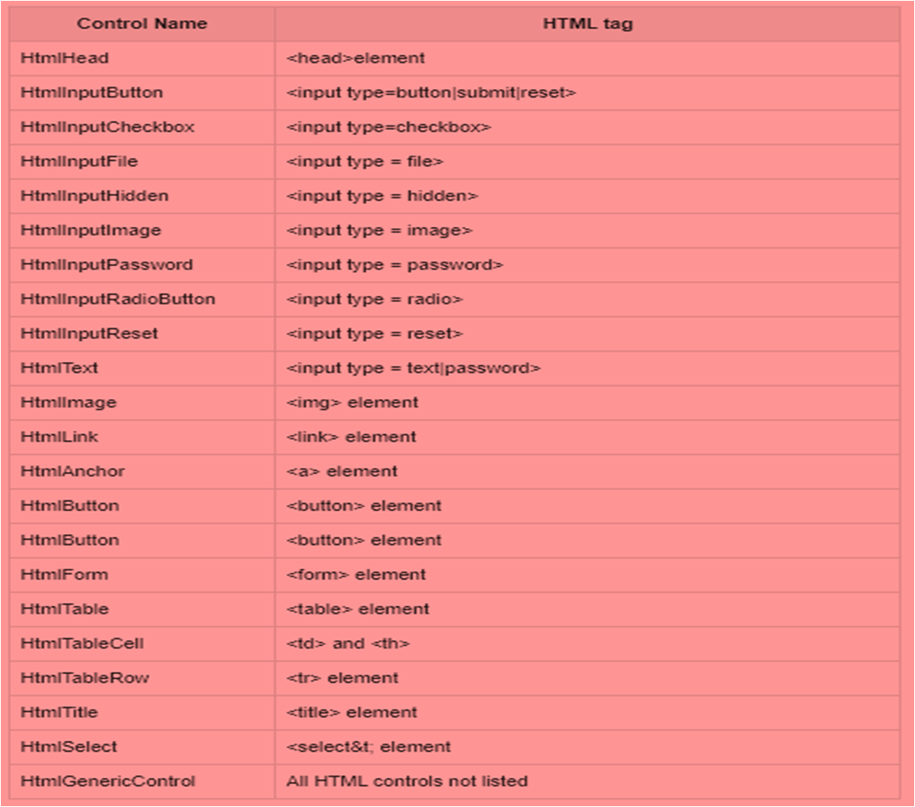
The following table describes the HTML server controls:
SIT1302 School of Computing

Slide 25
ASP.NET client side coding has two aspects:
Client side scripts : It runs on the browser and in turn speeds up the execution of page. For example, client side data validation which can catch invalid data and warn the user accordingly without making a round trip to the server.
Client side source code : ASP.NET pages generate this. For example, the HTML source code of an ASP.NET page contains a number of hidden fields and automatically injected blocks of JavaScript code, which keeps information like view state or does other jobs to make the page work.
Client Side Scripts
All ASP.NET server controls allow calling client side code written using JavaScript or VBScript. Some ASP.NET server controls use client side scripting to provide response to the users without posting back to the server. For example, the validation controls.
Apart from these scripts, the Button control has a property OnClientClick, which allows executing client-side script, when the button is clicked.
The traditional and server HTML controls have the following events that can execute a script when they are raised:
SIT1302 School of Computing

Slide 26
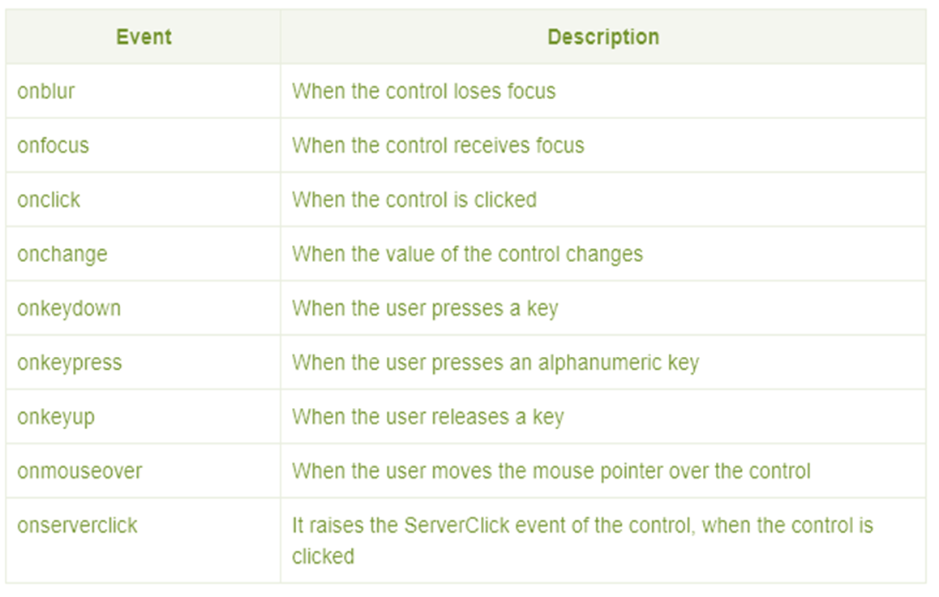
SIT1302 School of Computing

Slide 27
Client Side Source Code
We have already discussed that, ASP.NET pages are generally written in two files:
The content file or the markup file ( .aspx)
The code-behind file
The content file contains the HTML or ASP.NET control tags and literals to form the structure of the page. The code behind file contains the class definition. At run-time, the content file is parsed and transformed into a page class.
This class, along with the class definition in the code file, and system generated code, together make the executable code (assembly) that processes all posted data, generates response, and sends it back to the client.
SIT1302 School of Computing

Slide 28
Button Controls
ASP.NET provides three types of button control:
Button : It displays text within a rectangular area.
Link Button : It displays text that looks like a hyperlink.
Image Button : It displays an image.
When a user clicks a button, two events are raised: Click and Command.
Basic syntax of button control:
<asp:Button ID="Button1" runat="server" onclick="Button1_Click" Text="Click" / >
Common properties of the button control:
SIT1302 School of Computing

Slide 29
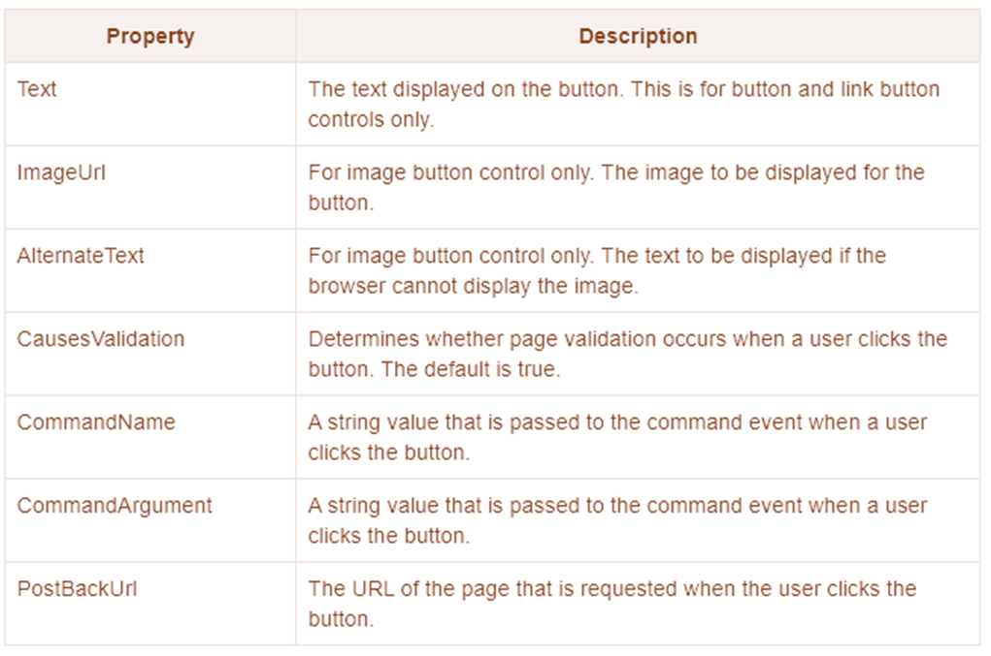
SIT1302 School of Computing

Slide 30
Text Boxes and Labels
Text box controls are typically used to accept input from the user. A text box control can accept one or more lines of text depending upon the settings of the TextMode attribute.
Label controls provide an easy way to display text which can be changed from one execution of a page to the next. If you want to display text that does not change, you use the literal text.
Basic syntax of text control:
<asp:TextBox ID="txtstate" runat="server" ></asp:TextBox>
Common Properties of the Text Box and Labels:
SIT1302 School of Computing

Slide 31
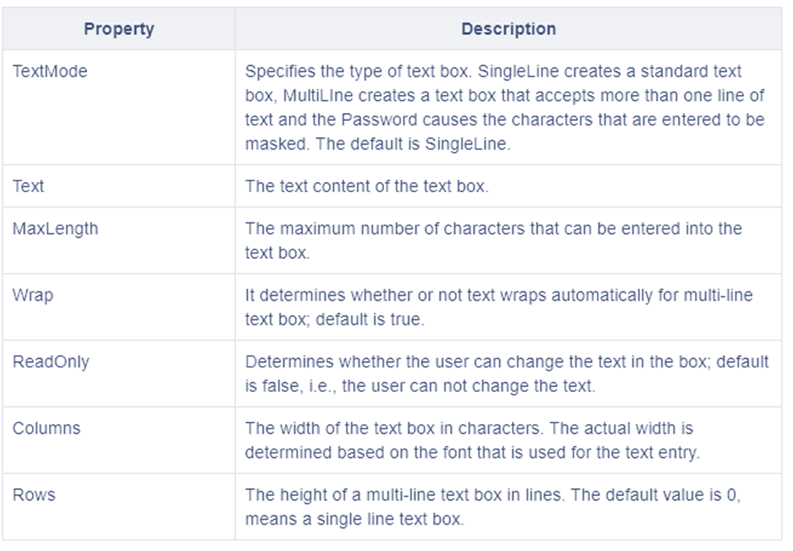
SIT1302 School of Computing

Slide 32
<Advertisements>
<Ad>
<ImageUrl>rose1.jpg</ImageUrl> <NavigateUrl>http://www.1800flowers.com</NavigateUrl> <AlternateText> Order flowers, roses, gifts and more </AlternateText> <Impressions>20</Impressions>
<Keyword>flowers</Keyword>
</Ad>
<Ad>
<ImageUrl>rose2.jpg</ImageUrl> <NavigateUrl>http://www.babybouquets.com.au</NavigateUrl> <AlternateText>Order roses and flowers</AlternateText> <Impressions>20</Impressions>
<Keyword>gifts</Keyword>
</Ad>
<Ad>
<ImageUrl>rose3.jpg</ImageUrl> <NavigateUrl>http://www.flowers2moscow.com</NavigateUrl> <AlternateText>Send flowers to Russia</AlternateText> <Impressions>20</Impressions>
<Keyword>russia</Keyword>
SIT1302 School of Computing

Slide 33
</Ad>
<Ad> <ImageUrl>rose4.jpg</ImageUrl> <NavigateUrl>http://www.edibleblooms.com</NavigateUrl> <AlternateText>Edible Blooms</AlternateText> <Impressions>20</Impressions> <Keyword>gifts</Keyword>
</Ad>
</Advertisements>
SIT1302 School of Computing

Slide 34
<form id="form1" runat="server">
<div> <asp:AdRotator ID="AdRotator1" runat="server" AdvertisementFile ="~/ads.xml" onadcreated="AdRotator1_AdCreated" />
</div> </form>
SIT1302 School of Computing

